Slide 1
Terraform Drift Detection

Slide 2
About Terraform Drift Detection
What is it?
Terraform Drift Detection is used to ensure your code consistently matches what is deployed, and when it doesn’t, it creates a work item to make you aware that a change outside of code needs to be investigated and resolved.
Why do I need it?
There's nothing more annoying than going to make a code change in Terraform, and when running a Plan, you find unexpected changes in the Plan because someone has made a change outside of Terraform.
By using Terraform Drift Detection, you are ensuring you and your team can be confident in that your code always matches what is deployed, even when you go weeks or months without touching the code.
How does it work?
You configure your existing pipeline to run on a schedule (ie: Mon to Fri @ 5am).
When the Scheduled pipeline runs and the Plan comes back clean, great!
But when the plan doesn’t come back clean, the pipeline generates you a task in Azure DevOps, adding it to the current sprint, making you and your team aware that a “Bad Actor” has made a change which isn’t in code.
Notes:
- Basically read this slide out.

Slide 3


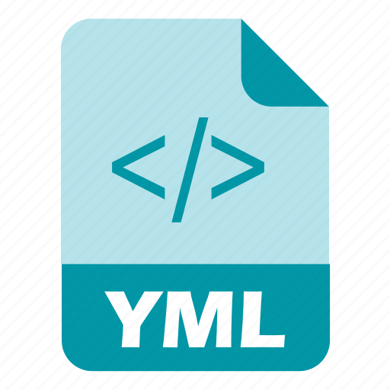



Requirements
Azure DevOps
Terraform Code
YAML Pipelines
Azure DevOps Extensions:
Create Work Item by Microsoft
Terraform by Microsoft DevLabs
Parent Work Item (Optional)
Notes:
- Quick overview of requirements

Slide 4
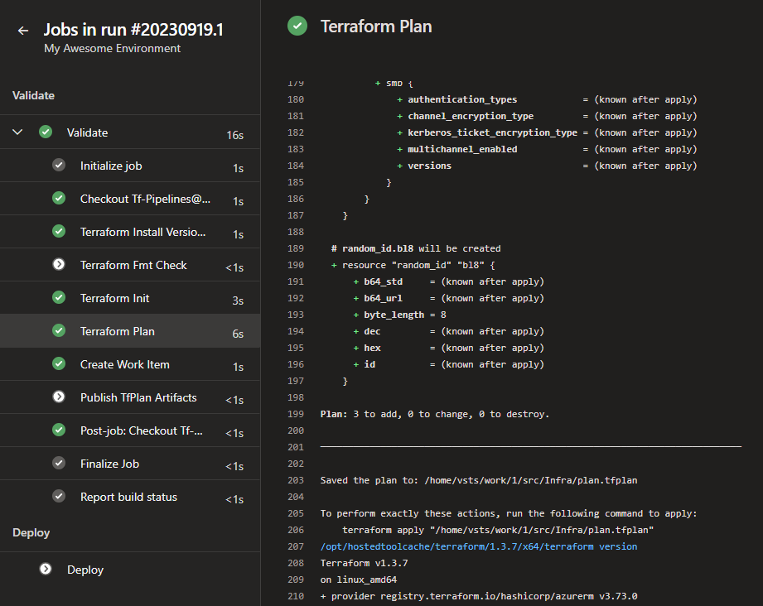
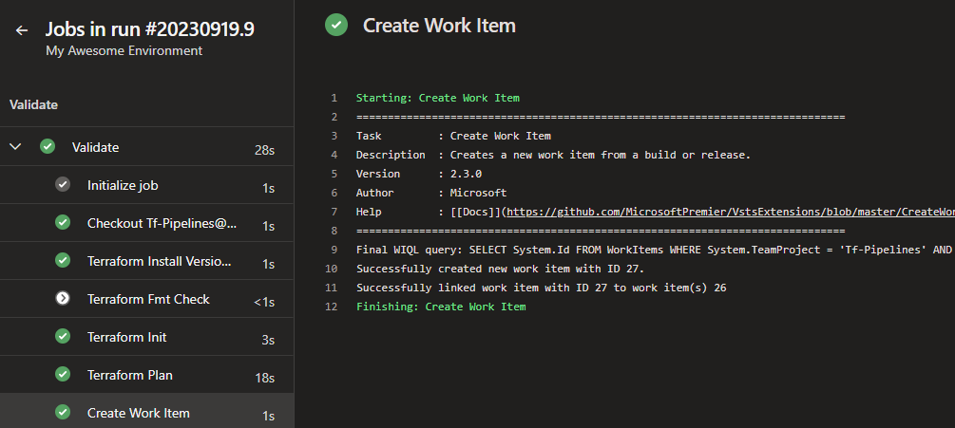
How does it look?
Notes:
Scheduled pipeline runs
Plan is generated, on this occasion there were changes (3 to add)
Because the run was Scheduled and there were planned changes, the Create Work Item task ran

Slide 5
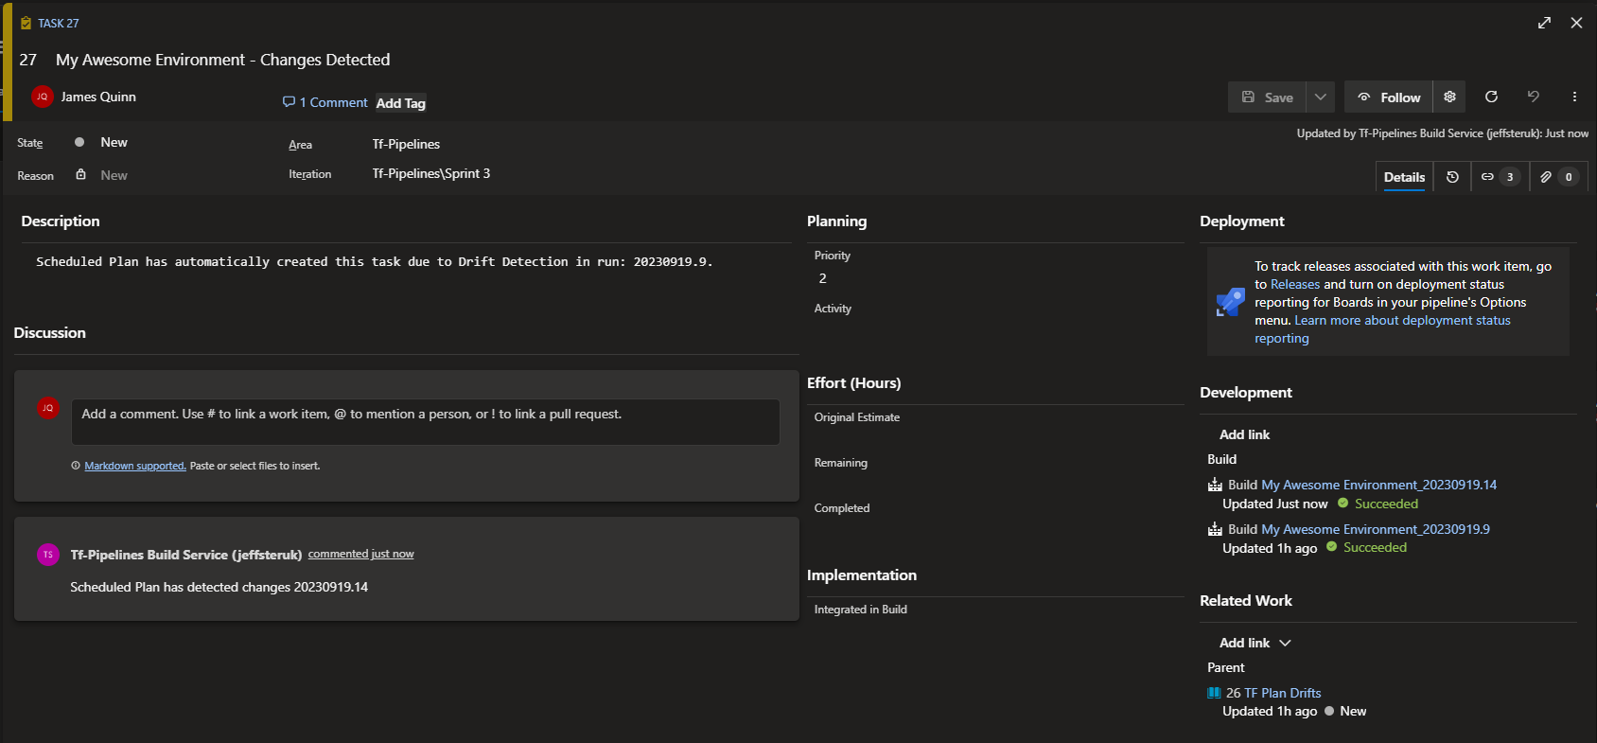
How does it look?
Notes:
The created work item
New Task
Name generated
Assigned to engineer or can be left unassigned
Custom description added
On future run, if the task is still New or Active, then instead of a new ticket being created which would be a duplicate, the scheduled pipeline add’s comments to the existing ticket
Ticket is linked to the Scheduled Run “Builds”, allowing you to click through to the pipeline run
Ticket is linked to a parent work item
Ticket is assigned to the current sprint

Slide 6
Work Item Options
Ref: Create Work Item - Visual Studio Marketplace
Things you can configure:
Work Item Title
Description
Linking (eg: to Parent)
Duplicate Detection
When a duplicate work item is detected, the existing work item can be updated instead of creating a new work item
And Much More….
Notes:
Scheduled pipeline runs
Plan is generated, on this occasion there were changes (3 to add)
Because the run was Scheduled and there were planned changes, the Create Work Item task ran

Slide 7
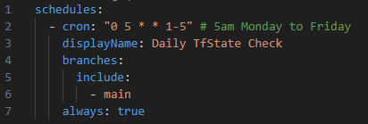
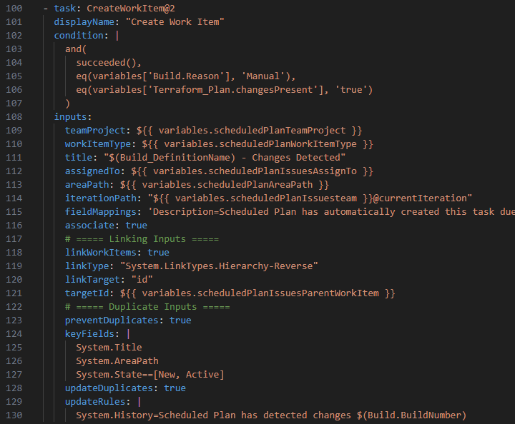
Technical Run-through
1. Add a scheduled run for your main (release) branch
2. Add Create Work Item task
Work Items are only created when needed due to the conditions applied:
eq(variables['Build.Reason'], 'Schedule’)
eq(variables['Terraform_Plan.changesPresent'], 'true')
Notes:
A quick Technical Run-through….
First you apply a schedule to your YAML Pipeline
Then you add the Create Work Item Task
There are two key conditions to be aware of….

Slide 8
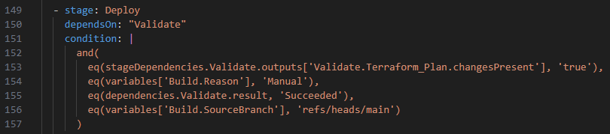
Technical Run-through
3. Only allow Deploy stage to run when required:
eq(stageDependencies.Validate.outputs['Validate.Terraform_Plan.changesPresent'], 'true’)
eq(variables['Build.Reason'], 'Manual’)
eq(dependencies.Validate.result, 'Succeeded’)
eq(variables['Build.SourceBranch'], 'refs/heads/main')
Notes:
And on the Deploy stage, we add conditions meaning Deploy is only allowed to run under these conditions.
If your environment has Approval Gates, these are still respected.

Slide 9
Where can I get the code from?
Ava Inner Source:
Terraform_Drift_Detection

